Slide 1
Rage
Revelation 8

Slide 2
A Vexing Question
Why do the nations rage?
God, 3000 years ago in Psalm 2:1 (ESV)
We are living in a very chaotic and confused world, and if we think that we're not in rage it's hypocritical. What we do is maybe suppress our rage and get sick from it; or you may take it out on your spouse or your family or the people around you.
Yoko Ono Japanese-born U.S. artist. Interview in Guardian (London) 20 Jan. 1996.

Slide 3
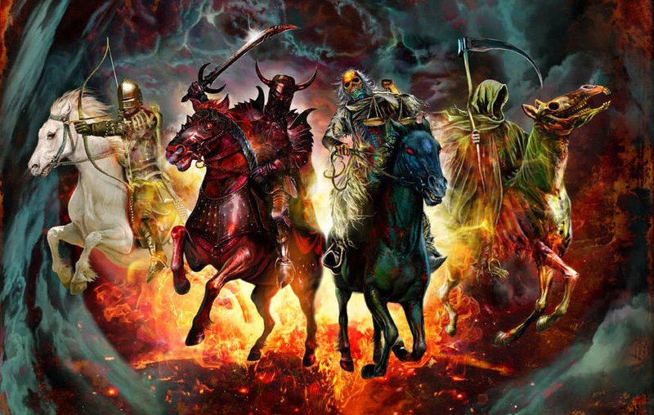
Background (Rev. 8)
Then I saw when the Lamb broke one of the seven seals, and I heard one of the four living creatures saying as with a voice of thunder, "Come!" Revelation 6:1 (NASB)
Notes:
Global “Conquest” (Peaceful)
Global War
Global Famine
Wholesale Slaughter

Slide 4
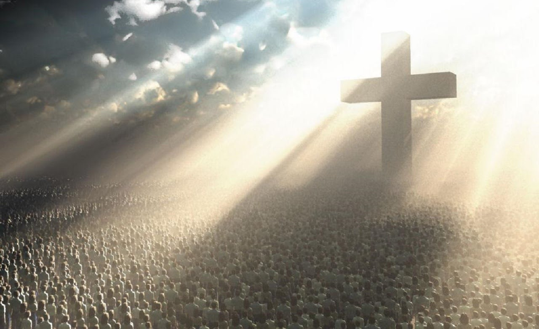
Background (Rev. 8)
"Do not harm the earth or the sea or the trees until we have sealed the bond-servants of our God on their foreheads." Revelation 7:3 (NASB)
Revelation 7:9 (NASB) After these things I looked, and behold, a great multitude which no one could count, from every nation and all tribes and peoples and tongues, standing before the throne and before the Lamb, clothed in white robes, and palm branches were in their hands;
Revelation 7:4 (NASB) And I heard the number of those who were sealed, one hundred and forty-four thousand sealed from every tribe of the sons of Israel

Slide 5
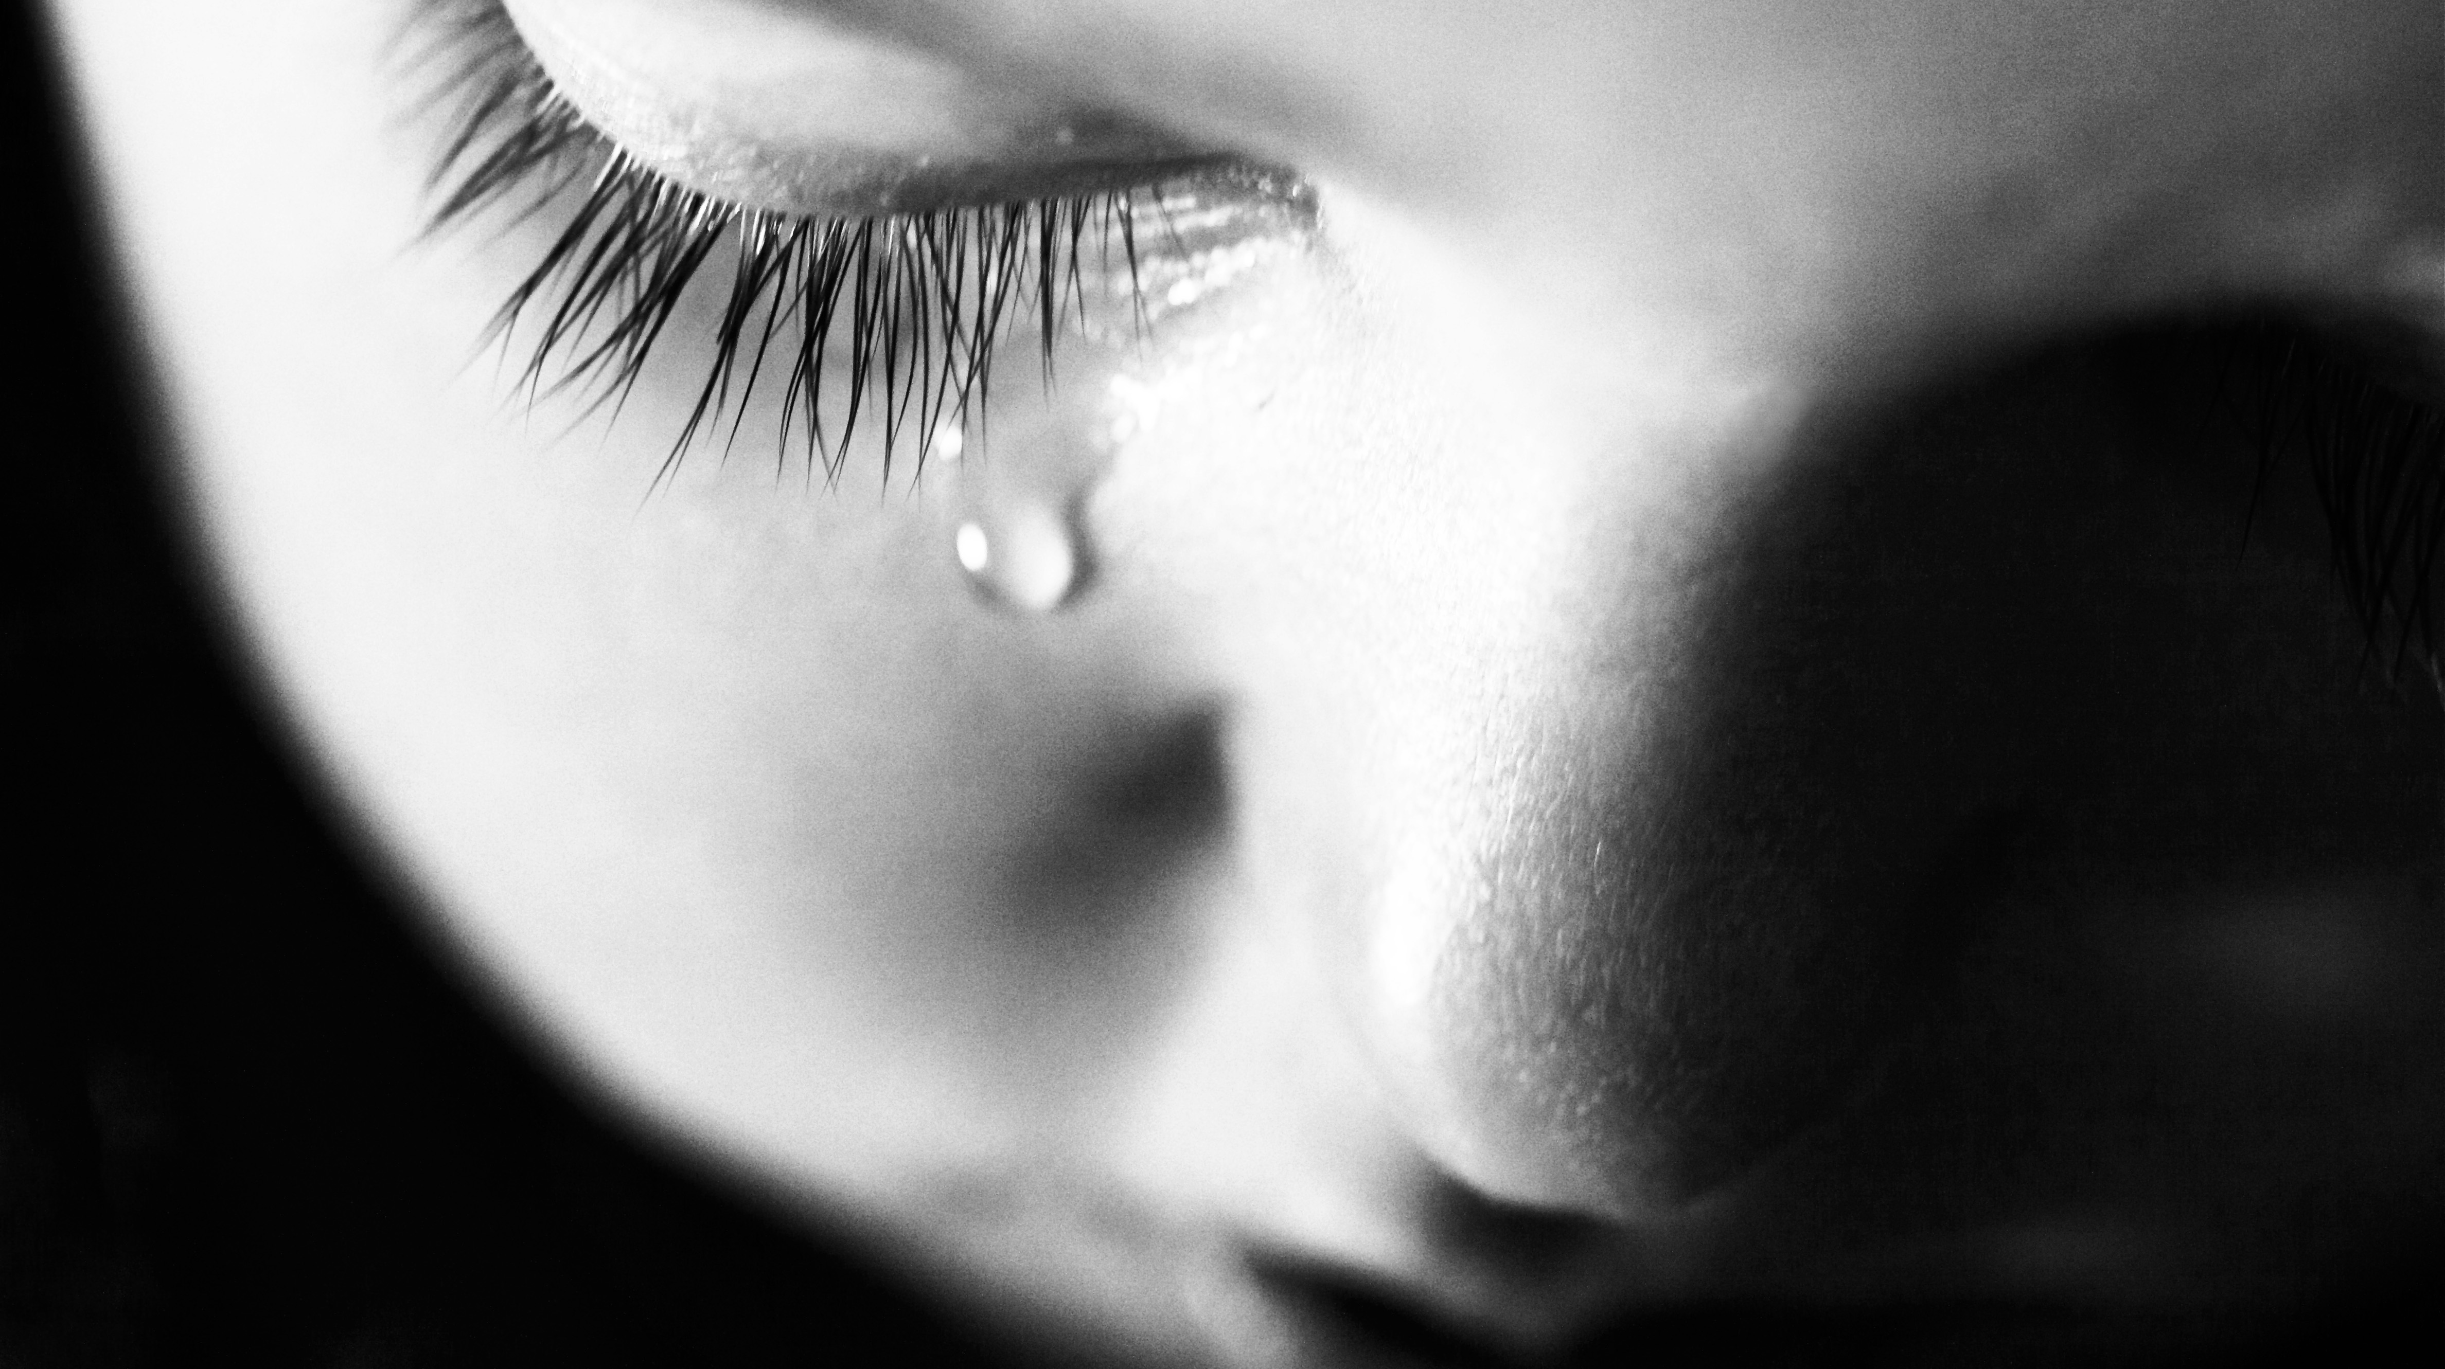
Background (Rev. 8)
“the Lamb in the center of the throne will be their shepherd, and will guide them to springs of the water of life; and God will wipe every tear from their eyes.” Rev. 7:17
Notes:
This=Our Heart’s Desire
→ Remember Youth? Shock? Dismay?
JC=Put these longings in2 r Hearts
→We Know There’s Something Better

Slide 6
Meanwhile…
When the Lamb broke the seventh seal there was silence in heaven for about half an hour Revelation 8:1
Notes:
** MOVIE **

Slide 7
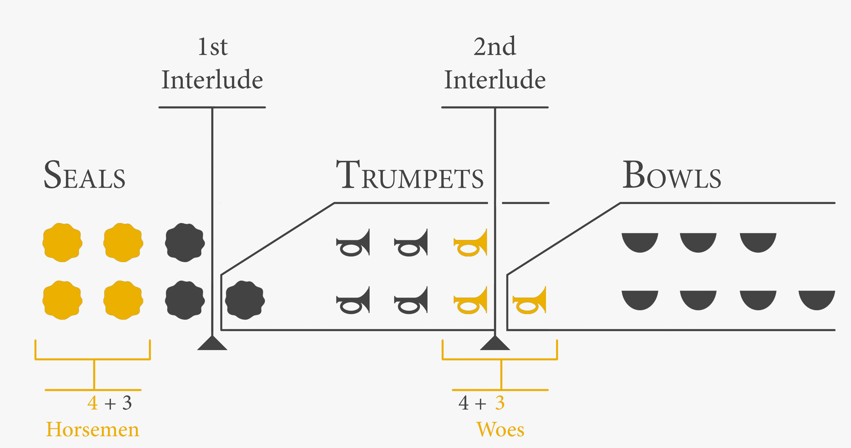
And I saw the seven angels who stand before God, and seven trumpets were given to them. Revelation 8:2

Slide 8
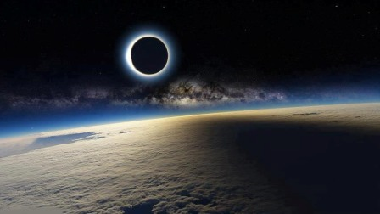
Rev. 8: Rage Unrestrained
Another angel came and stood at the altar, holding a golden censer; and much incense was given to him, so that he might add it to the prayers of all the saints on the golden altar which was before the throne. And the smoke of the incense, with the prayers of the saints, went up before God out of the angel's hand. Then the angel took the censer and filled it with the fire of the altar, and threw it to the earth; and there followed peals of thunder and sounds and flashes of lightning and an earthquake. Rev.8:3-5
and they cried out with a loud voice, saying, "How long, O Lord, holy and true, will You refrain from judging and avenging our blood on those who dwell on the earth?" Revelation 6:10 (NASB)
Notes:
Incense=PRAYERS “Sweet Savor…”
** Rev.8=Answers **Rev.6=Source

Slide 9
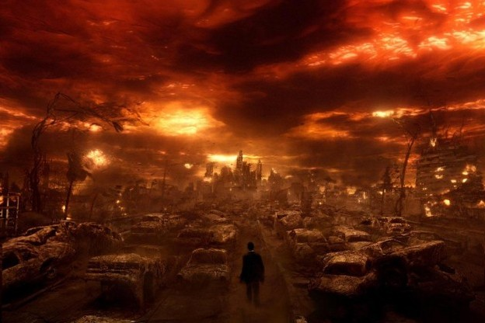
Rev. 8: Rage Unrestrained
Romans 12:19-20 (NASB) Never take your own revenge, beloved, but leave room for the wrath of God, for it is written, “Vengeance is Mine, I will repay," says the Lord.
“But if your enemy is hungry, feed him, and if he is thirsty, give him a drink; for in so doing you will heap burning coals on his head."
Notes:
Results=NOT PRETTY → “?? G. Allow 2 Continue??”
ANSW=Will Look Like This… ?? U WANT ??
BETTER= **Ro.12 Let G Judge→ We=Rageaholics 2!!
BETTER STILL=**Ro.12b Help, ~Hurt
AP: THANK G we ~See This 2Day… → 2Dy=Compass

Slide 10
Rev. 8: Rage Unrestrained
there followed peals of thunder and sounds and flashes of lightning and an earthquake. Rev.8:3-5
HAS to be Warfare
Zech. 12
Zech. 14
Isaiah 13
Isaiah 13:7-8 (NASB) Therefore all hands will fall limp, And every man's heart will melt. They will be terrified, Pains and anguish will take hold of them; They will writhe like a woman in labor, They will look at one another in astonishment, Their faces aflame.
Isaiah 13:12 (NASB)
I will make mortal man scarcer than pure gold And mankind than the gold of Ophir.
Zechariah 14:12 (NASB) Now this will be the plague with which the LORD will strike all the peoples who have gone to war against Jerusalem; their flesh will rot while they stand on their feet, and their eyes will rot in their sockets, and their tongue will rot in their mouth.
Zechariah 12:2 (NASB) "Behold, I am going to make Jerusalem a cup that causes reeling to all the peoples around; and when the siege is against Jerusalem, it will also be against Judah.
Zechariah 14:2 (NASB) For I will gather all the nations against Jerusalem to battle…
Notes:
Rev.8:5ff=**WAR → OT Proph’s
**Zech 12 → ?? Jerusalem @Cntr ??!! →WE KNOW!!
**Zech. 14 → @Jerusalem=Epicenter ** PLAGUE
** Is. 13 → ?? Possible ?? → ** FACES ON FIRE??

Slide 11
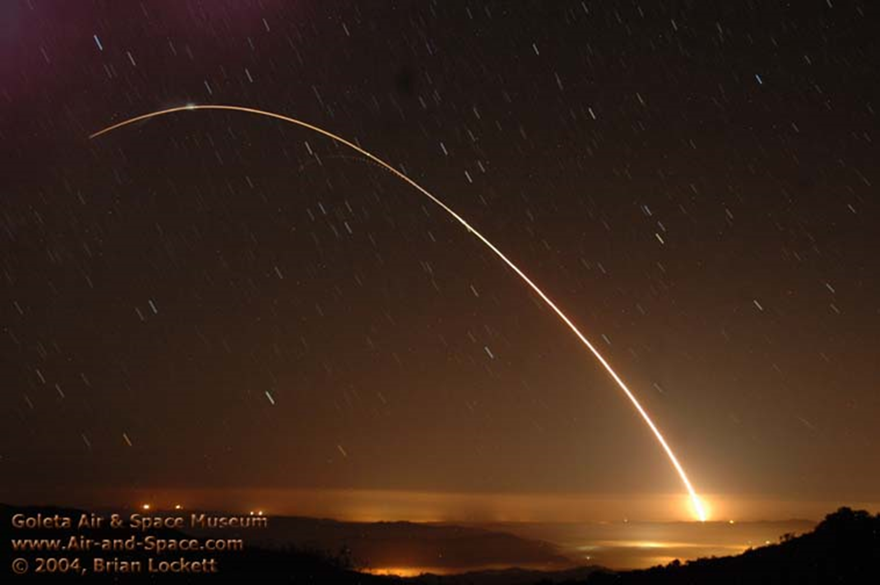
Rev. 8: Rage Unrestrained
Revelation 8:7 The first sounded, and there came hail and fire, mixed with blood, and they were thrown to the earth; and a third of the earth was burned up, and a third of the trees were burned up, and all the green grass was burned up.
Notes:
~Allegorical = REAL PROBS in Ch. Hist →Anti-Semitism
** ~Normal Hail → Looks Like ?? ~Seen Explosions B4

Slide 12
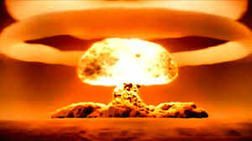
Rev. 8: Rage Unrestrained
Revelation 8:8-9 (NASB) The second angel sounded, and something like a great mountain burning with fire was thrown into the sea; and a third of the sea became blood, and a third of the creatures which were in the sea and had life, died; and a third of the ships were destroyed.
Notes:
?? “Burn. Mtn.” == ?? Volcanoe → **^Hydrogen Bomb

Slide 13
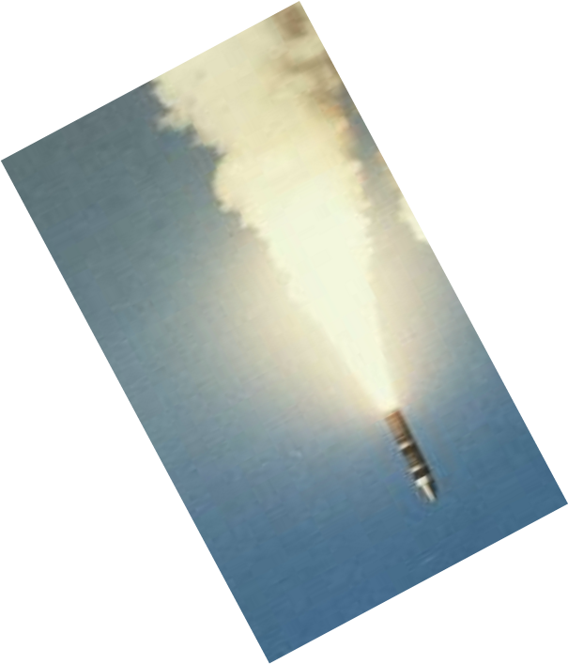
Rev. 8: Rage Unrestrained
Revelation 8:10-11 (NASB) The third angel sounded, and a great star fell from heaven, burning like a torch, and it fell on a third of the rivers and on the springs of waters. The name of the star is called Wormwood; and a third of the waters became wormwood, and many men died from the waters, because they were made bitter.
Notes:
?? “Burn..Torch” = Amaz.Effects! “Hv. 2 Allegorize…”
→ ** Until 1945

Slide 14
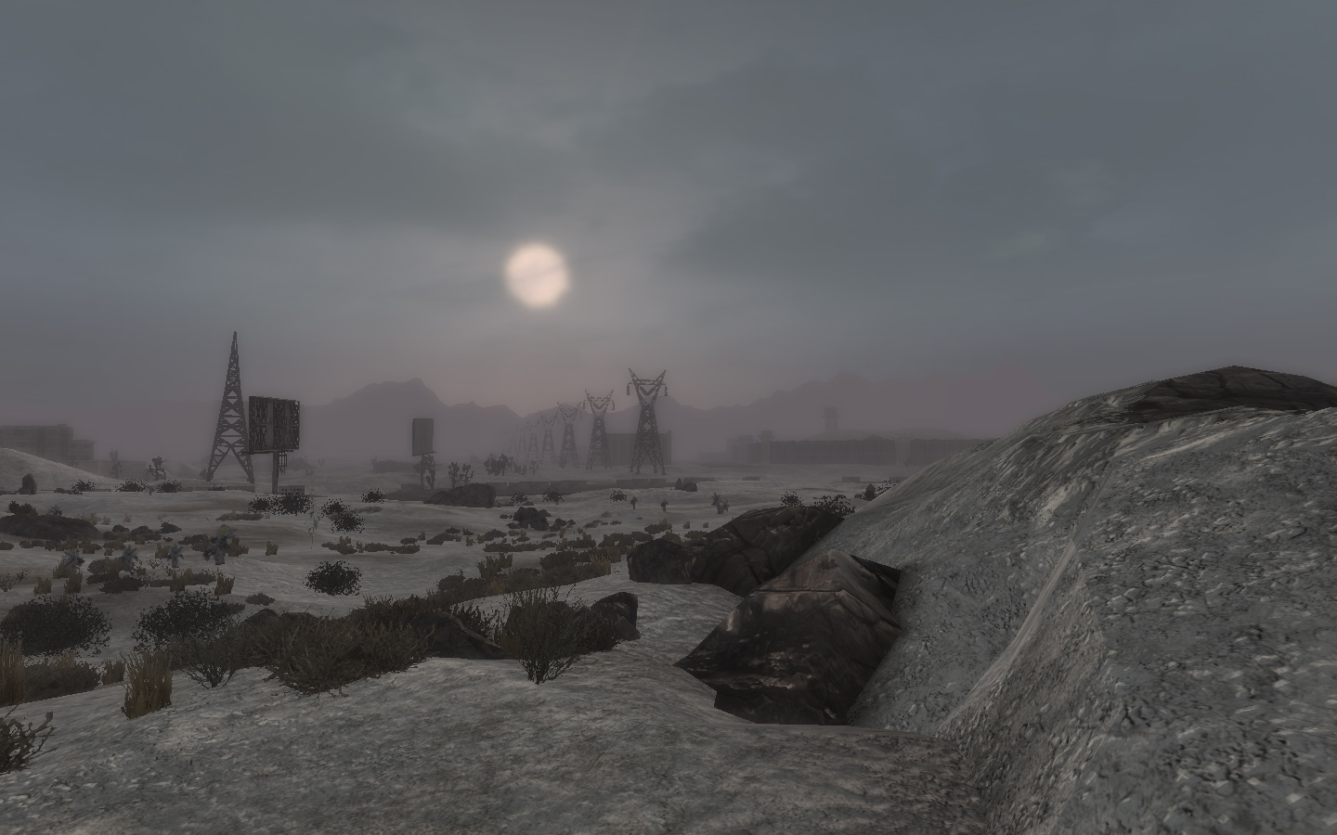
Rev. 8: Rage Unrestrained
Revelation 8:12 (NASB) The fourth angel sounded, and a third of the sun and a third of the moon and a third of the stars were struck, so that a third of them would be darkened and the day would not shine for a third of it, and the night in the same way.
Isaiah 13:10 For the stars of heaven and their constellations Will not flash forth their light; The sun will be dark when it rises And the moon will not shed its light…
Notes:
“Struck” = “Darkened” → ** Nuke Winter
==** Is.13 / Zech / Etc.

Slide 15
Rev. 8: Rage Unrestrained
Revelation 8:13 (NASB) Then I looked, and I heard an eagle flying in midheaven, saying with a loud voice, "Woe, woe, woe to those who dwell on the earth, because of the remaining blasts of the trumpet of the three angels who are about to sound!"
Notes:
=VISION of Future…
“Woe, woe…” = “BAD NEWS!!”

Slide 16
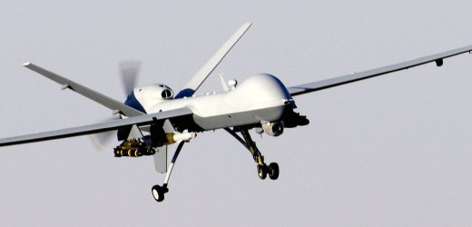
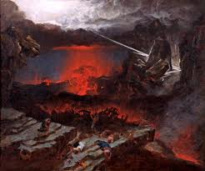
Rev. 9: Rage Unrestrained
Revelation 9:7-10 (NASB) The appearance of the locusts was like horses prepared for battle; and on their heads appeared to be crowns like gold, and their faces were like the faces of men. They had hair like the hair of women, and their teeth were like the teeth of lions. They had breastplates like breastplates of iron; and the sound of their wings was like the sound of chariots, of many horses rushing to battle. They have tails like scorpions, and stings; and in their tails is their power to hurt men for five months.
Revelation 9:1-5 Then the fifth angel sounded, and I saw a star from heaven which had fallen to the earth; and the key of the bottomless pit was given to him. He opened the bottomless pit, and smoke went up out of the pit, like the smoke of a great furnace; and the sun and the air were darkened by the smoke of the pit. Then out of the smoke came locusts upon the earth, and power was given them, as the scorpions of the earth have power. They were told not to hurt the grass of the earth, nor any green thing, nor any tree, but only the men who do not have the seal of God on their foreheads. And they were not permitted to kill anyone, but to torment for five months; and their torment was like the torment of a scorpion when it stings a man.
2 Thessalonians 2:7 For the mystery of lawlessness is already at work; only he who now restrains will do so until he is taken out of the way… For this reason God will send upon them a deluding influence so that they will believe what is false,
Revelation 9:6 And in those days men will seek death and will not find it; they will long to die, and death flees from them.
Notes:
=** DRONES? ** v.7ff=Descript.
**Prob.HELL Itself =**Restrained
AP: NAÏVE=Thnk “all spirits=SAME” → ACCUSATION/Torment=S’s Weapons
** S=Makes DEATH ATTRACTIVE → “Thief…Murderer”

Slide 17
Rev. 9: Rage Unrestrained
Revelation 9:12 (NASB) The first woe is past; behold, two woes are still coming after these things.
Notes:
BAD NEWS

Slide 18
Rev. 9: Rage Unrestrained
Revelation 9:13-16 (NASB) Then the sixth angel sounded, and I heard a voice from the four horns of the golden altar which is before God, one saying to the sixth angel who had the trumpet, "Release the four angels who are bound at the great river Euphrates." And the four angels, who had been prepared for the hour and day and month and year, were released, so that they would kill a third of mankind. The number of the armies of the horsemen was two hundred million; I heard the number of them.
Notes:
=Certainly Possible → CHINA!!

Slide 19
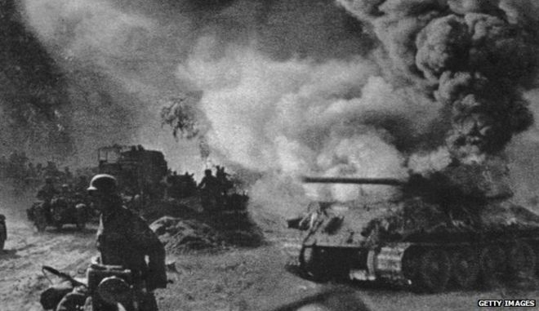
Rev. 9: Rage Unrestrained
Revelation 9:17-19 (NASB) And this is how I saw in the vision the horses and those who sat on them: the riders had breastplates the color of fire and of hyacinth and of brimstone; and the heads of the horses are like the heads of lions; and out of their mouths proceed fire and smoke and brimstone. A third of mankind was killed by these three plagues, by the fire and the smoke and the brimstone which proceeded out of their mouths. For the power of the horses is in their mouths and in their tails; for their tails are like serpents and have heads, and with them they do harm.
Notes:
Descript = ** TANKS??

Slide 20
Rage Finale
Daniel 12:1 (NASB) “There will be a time of distress such as never occurred since there was a nation until that time; and at that time your people, everyone who is found written in the book, will be rescued.
Daniel 12:4 (NASB) "But as for you, Daniel, conceal these words and seal up the book until the end of time; many will go back and forth, and knowledge will increase."

Slide 21
Rev. 9: Rage Unrestrained
Revelation 9:20-21 (NASB) The rest of mankind, who were not killed by these plagues, did not repent of the works of their hands, so as not to worship demons, and the idols of gold and of silver and of brass and of stone and of wood, which can neither see nor hear nor walk; and they did not repent of their murders nor of their sorceries nor of their immorality nor of their thefts.
Notes:
=AMAZING!! → CURSE @ GOD

Slide 22
2 Worlds
James 3:13-18 if you have bitter jealousy and selfish ambition in your heart, do not be arrogant and so lie against the truth. This wisdom is not that which comes down from above, but is earthly, natural, demonic. For where jealousy and selfish ambition exist, there is disorder and every evil thing.
But the wisdom from above is first pure, then peaceable, gentle, reasonable, full of mercy and good fruits, unwavering, without hypocrisy. And the seed whose fruit is righteousness is sown in peace by those who make peace.
Notes:
2 Worlds → ** DEMONIC = Culminates in Rev.8/9 = RAGE
** G’s World → GOSP: ~U Receive Gs PEACE?

Slide 24
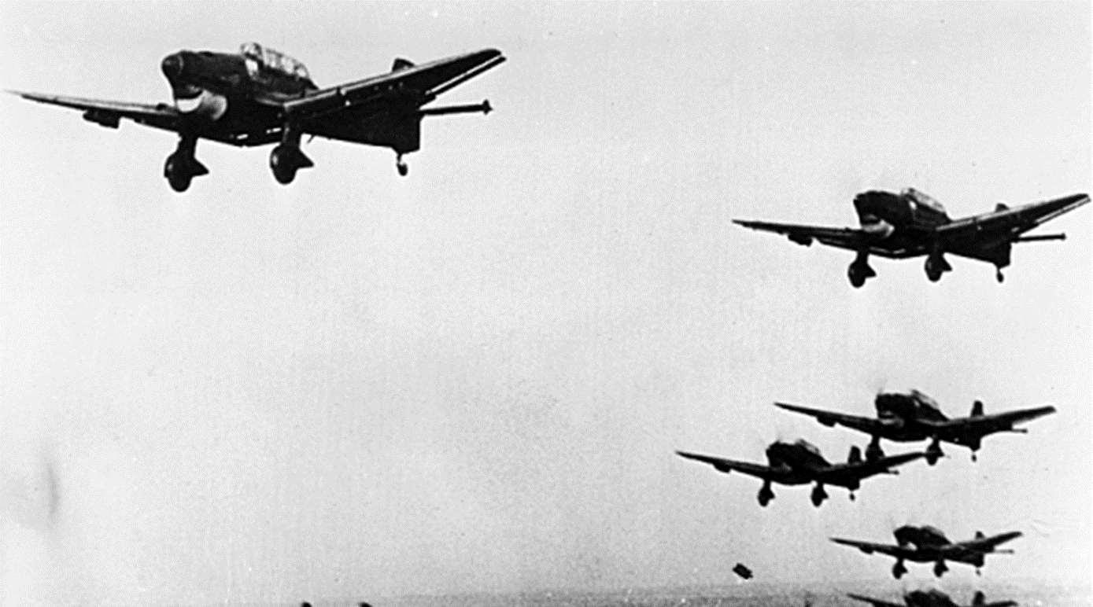
Rev. 8: Rage Unrestrained
Revelation 8:7 The first sounded, and there came hail and fire, mixed with blood, and they were thrown to the earth; and a third of the earth was burned up, and a third of the trees were burned up, and all the green grass was burned up.
Notes:
~Allegorical = REAL PROBS in Ch. Hist →Anti-Semitism
** Looks Like ?? ~Seen Explosions B4 →

Slide 25
Rev. 8: Global Rage Released

Slide 26
A Vexing Prophecy
Means
United World
Anti-Christ
Grand, “Empty” Plans
Enraged World
Why are the nations in an uproar, and devising an empty plan? The kings of the earth take their stand [together], and the rulers take counsel together Against the LORD and against His Messiah, saying, “Let us tear their fetters apart And cast away their cords from us!”
Psalm 2:1-3 (NASB)

